Slide 1
Comparing Pre and Post-retrofit backend temperatures
Focus on all available data in monitor and scan_stat databases.
Components analyzed include mostly those within 50K or colder shells. Outlying points removed.
Kyle Devereaux
3/5/2021

Slide 2
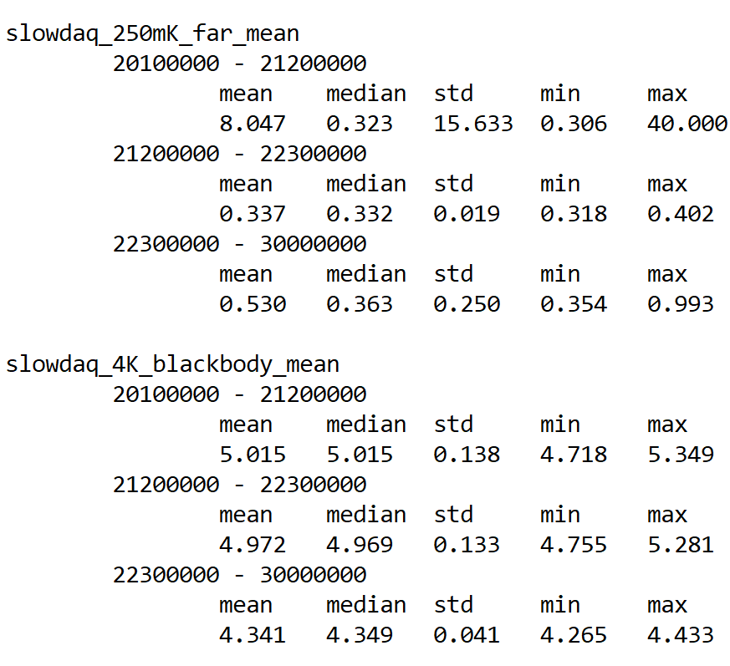
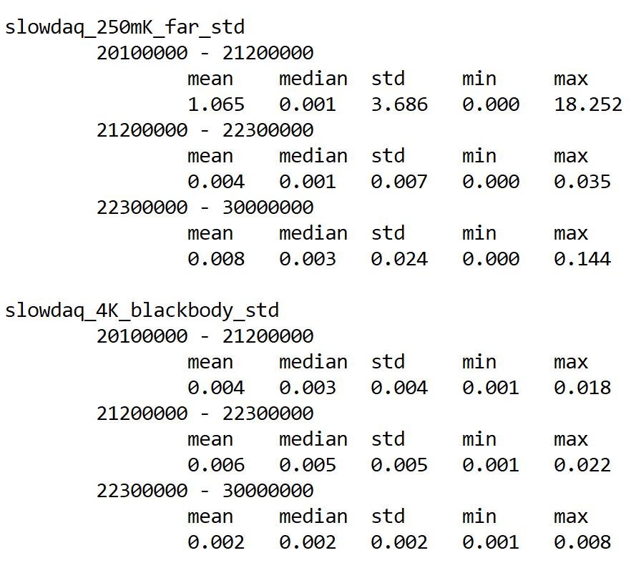
Tables (1): 250mK far and it’s stability
Post-retrofit, the focal plane as a median temperature comparable to the pre-retrofit median of ~350mK, but on average is ~200mK warmer.
Given the ~1K max and larger std, the high average is most likely the result of a small number readings which were taken when the fridge wasn’t a base temperature. Similar to the readings for runs 20100000 - 21200000. Inspecting the data, there was indeed a two anomalous runs which were already discussed here.
Stability of individual focal plane temperature readings (given as the std) agrees with the above. Focal plane std has median comparable to pre-retrofit, but very high max @ 144mK.

Slide 3
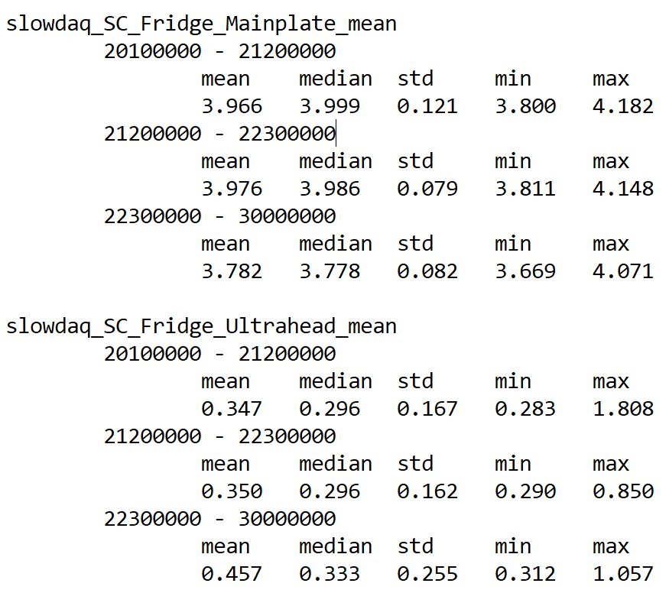
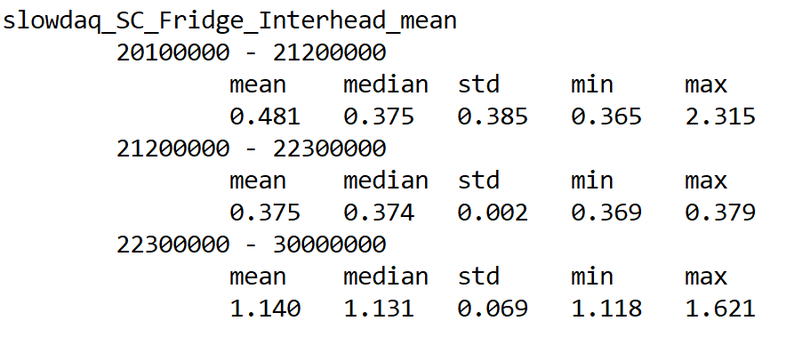
Tables (2): 4K
backend cryogenics
SC mainplate mean temperature decreased slightly over the retrofit.
SC ultrahead mean increased ~100mK (however, variance of these averages is quite high)
SC interhead mean readings increased dramatically by ~800mK. Variance is very low. So high it seems unphysical. (see slide 5)

Slide 4
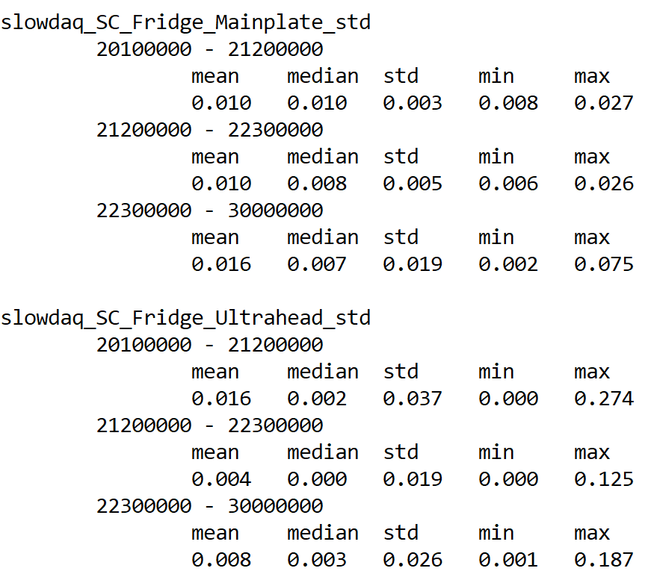
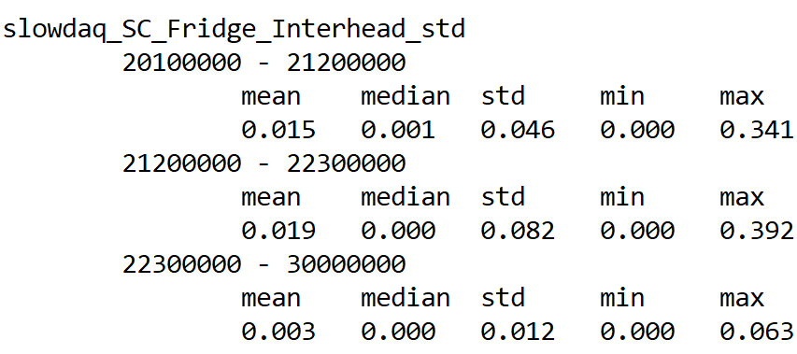
Tables (3): 4K
backend cyrogenics stability
Mainplate, ultrahead, and interhead individual reading stabilities all comparable to pre-retrofit values.
All three sensors have high stability, so conclusion on last page are probably reasonable.
Some values appear as zero; they are not. This was from formatting .

Slide 5
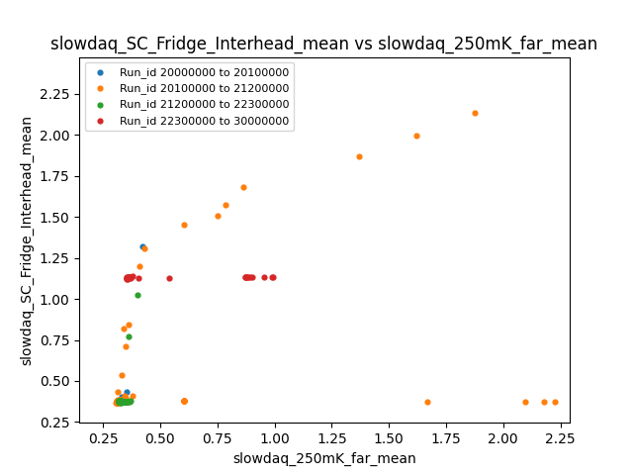
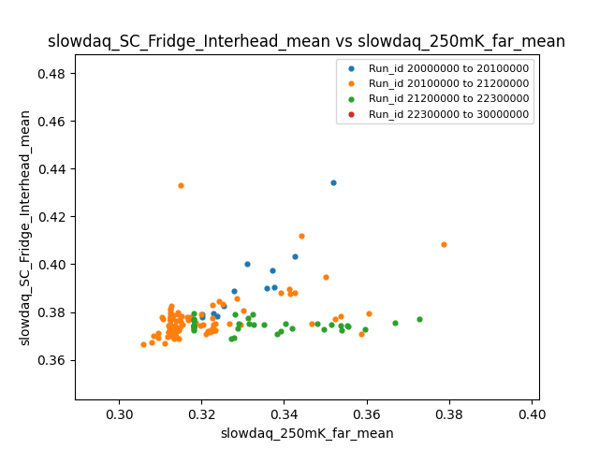
SC interhead and 250mK far temperatures
Post-retrofit (red) data not correlated with focal plane temperature while pre-retrofit is at least somewhat correlated. This is another convincing reason why the interhead temperatures may be faulty.
Note the “logarithmic” looking readings for run 20100000 - 21200000. These I also attribute to faulty readings and were first found here.

Slide 6
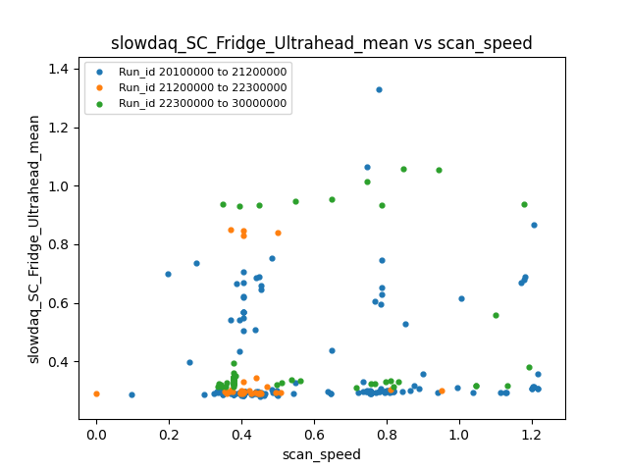
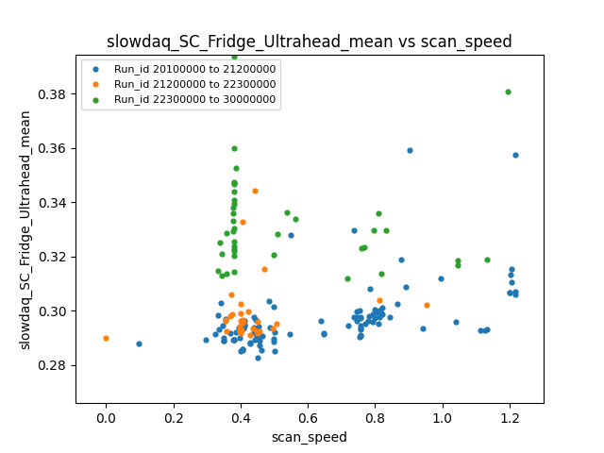
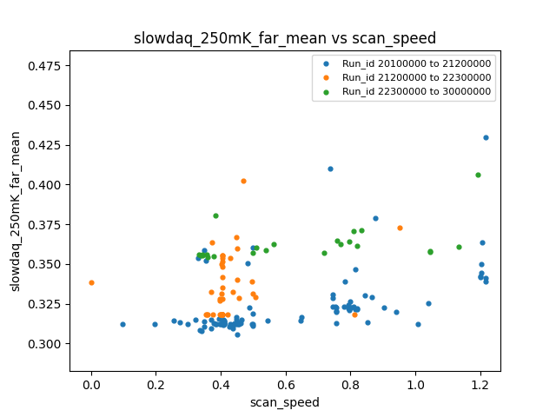
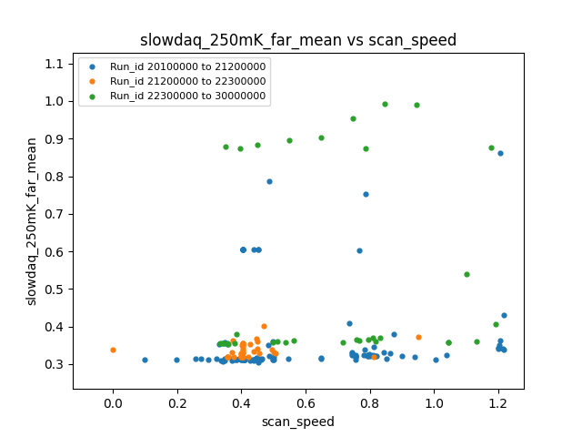
Ultrahead and focal plane wrt scan speed
(speculative)
Seems like a focal plane heating pattern may exist pre and post retrofit (roughly sketched)
While the data >0.5K in the rightmost plots is either unphysical or recorded when the fridge is not in base temperature, the erroneous pattern of runs 22300408-9 looks (very roughly) similar to patterns in the base temperature range.
In general, temperature seems to increase steadily for scan_speeds >0.6.

Slide 7
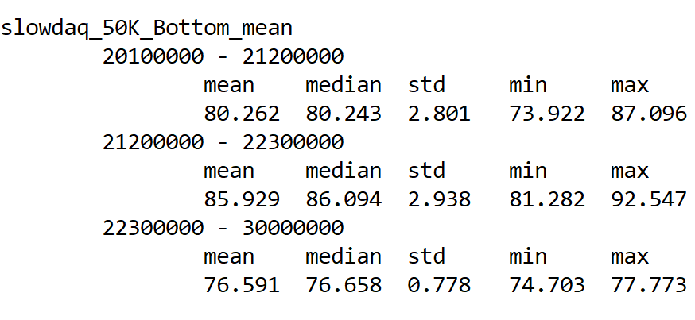
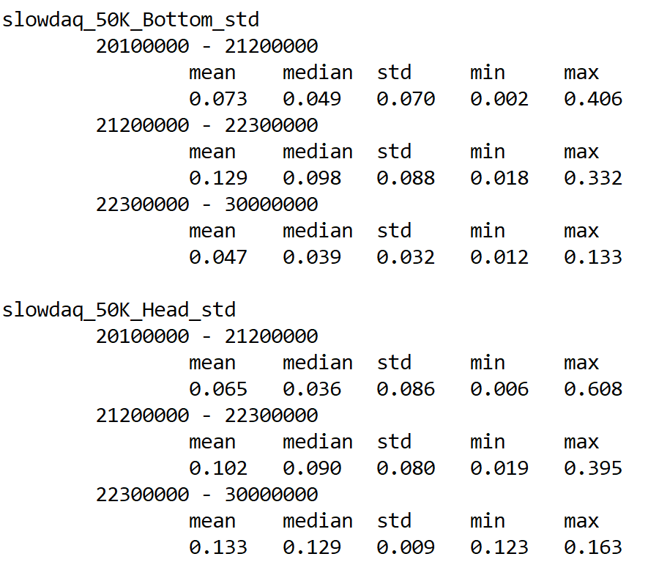
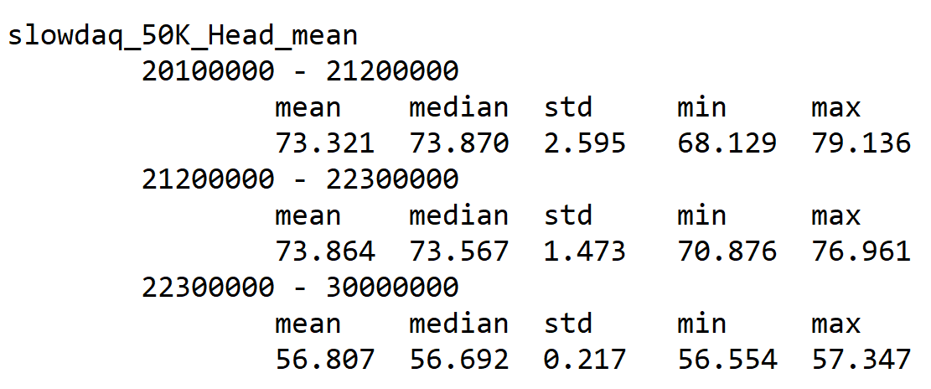
Tables (4): 50K bottom and head
50K bottom decreased significantly by ~9.5K and 50K head decreased moderately by ~7K.
Stability of both temperature readings increased dramatically.
Stability of individual temperature readings (see std data) remained comparable to pre-retrofit.

Slide 8
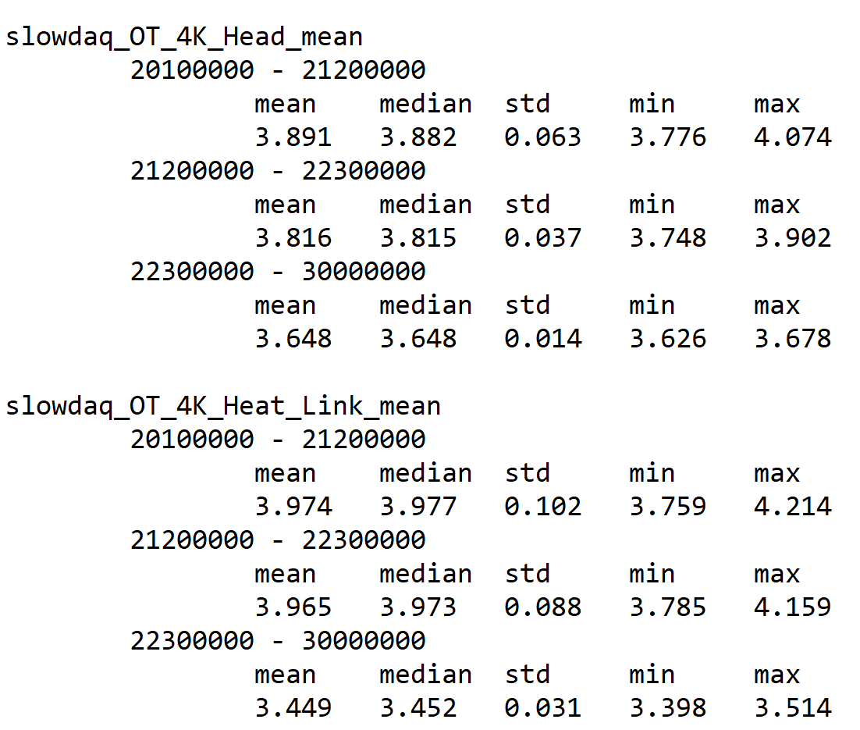
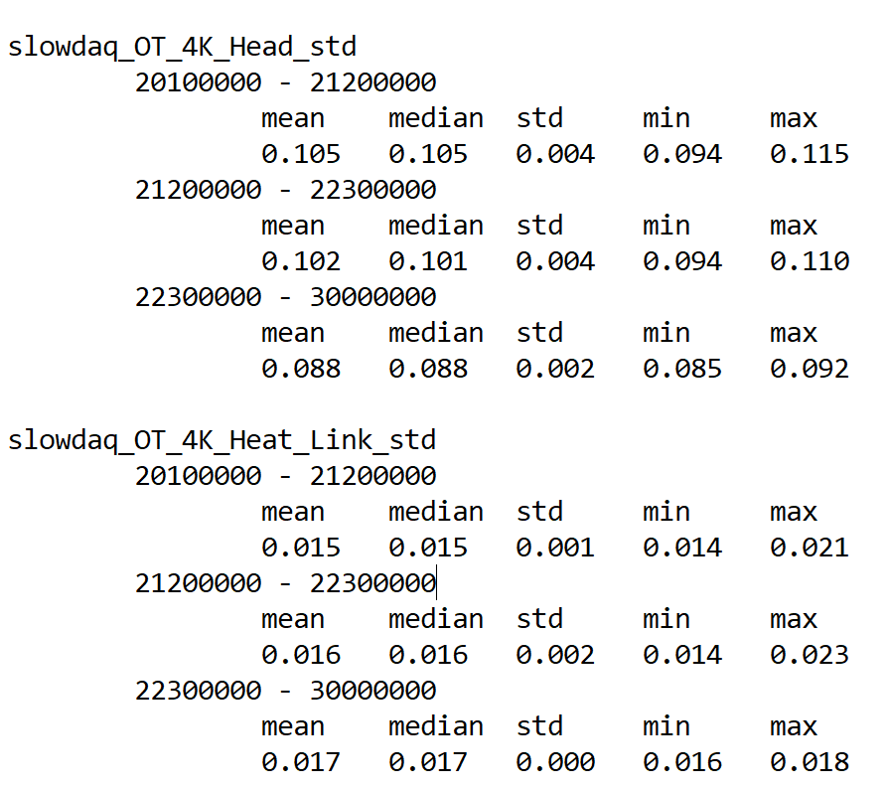
Tables (5): 4K OT and blackbody
OT 4K Head and Heat Link, and 4K Blackbody all decreased markedly from the retrofit.
OT 4K head decreased by ~0.15K, OT 4K heat link by ~0.42K, and 4K blackbody by about ~0.63K.
Above supported by the still very high level of stability. For all three components, stability actually increased.

Slide 9
Faulty sensors
Post-retrofit, there are many more sensors which return faulty readings (i.e. always reading a single value or unphysically large/small values) or no reading at all.
Here is a partial list of the faulty sensors:
Backend
Backend 4K head
Backend 4K heat link
SQUID card
OT
Aperture lens
Collimator lens
Field lens
Lyot stop blackbody
50K filter left
50K filter right
Mirrors
All primary mirror sensors

Slide 10
Runid reference table
Modifications were made on the receiver between the 200*****, 201*****, 212***** , 223***** runs
Many differences and nonlinearities between temperature data sets can be explained by considering the data separately in these periods:
 | First runid | First date | Last runid | Last date
Original receiver | 20000021 | 2018-12-26 | 20000327 | 2019-03-06
After first round of modifications | 20100001 | 2019-03-08 | 20102003 | 2019-11-30
After second round of modifications | 21200001 | 2020-01-30 | 21200399 | 2020-03-19
Post-retrofit | 22300000 | 2021-01-07 | 22300523* | 2021-01-29*
*most recent data in database
https://bolowiki.berkeley.edu/bin/view/Main/PB2aDeploymentObservations

